Slide 1

NUS-ISS · PATTERN RECOGNITION SYSTEMS · PRACTICE MODULE · FIRST PRESENTATION
A Multimodal Medical Imaging Assistant for Pulmonary Infection Classification
Chest CT + de-identified clinical information → Aspergillus / non-Aspergillus fungal / non-fungal infection, with confidence, lesion localisation and severity
Lai Wendi
A0352629X
Practice Project Group (FT) 26 · NUS-ISS
Tang Shiyan
A0329902B
Xia Yan
A0352818X
6 October 2026
Zhou Jiasheng
A0315819X
Notes:
[Slide 1 · Speaker A · ≈ 0:21]
Good morning, everyone. We are Group 26. Our project is a multimodal imaging assistant: we want to find out whether a model that looks at both a chest CT and a few routine clinical facts can tell three kinds of lung infection apart.

Slide 2
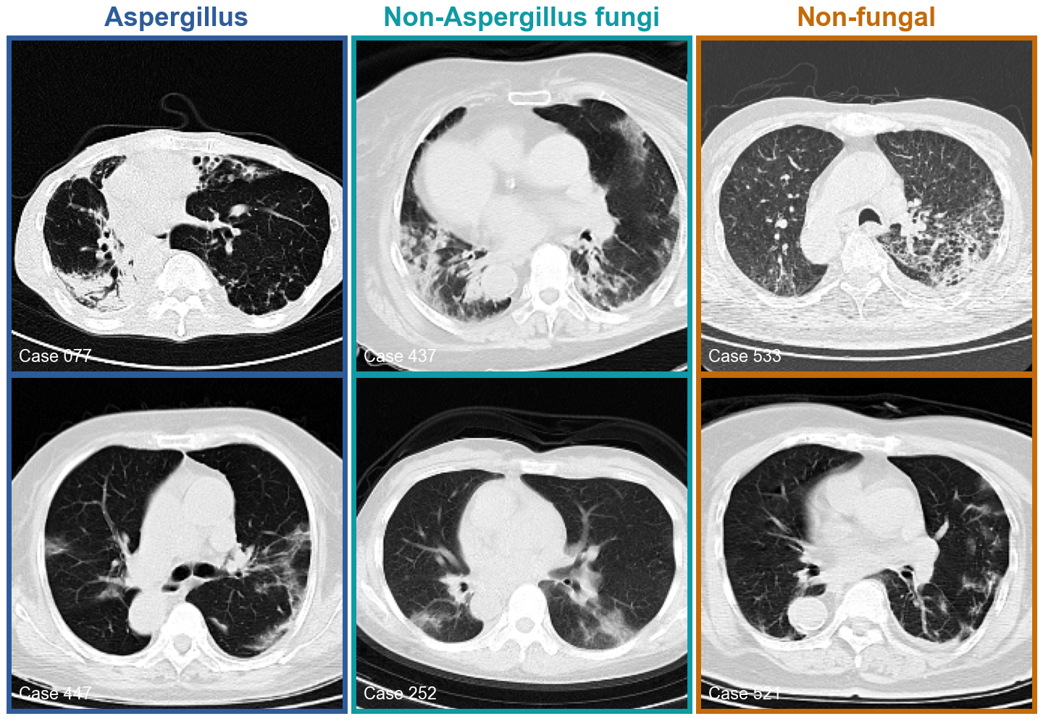
Introduction
Scope & Data
System Design
Progress & Results
Plan
Introduction — Clinical Problem and Project Objectives
CLINICAL PROBLEM
PROJECT GOAL
Aspergillus, other fungal and non-fungal (bacterial / viral) pneumonias overlap on chest CT — consolidation, nodules, cavities, ground-glass. They need different first-line treatment.
A research prototype that reads one patient's chest CT and clinical record and returns a three-class infection prediction with confidence — decision support, not a diagnosis.
OBJECTIVES
01
Classify
Aspergillus vs non-Aspergillus fungi vs non-fungal, with calibrated confidence
02
Fuse modalities
Show whether CT + clinical beats CT-only and clinical-only
03
Explain
Highlight suspicious lung regions (saliency); severity estimate as stretch goal
04
Study the data regime
Pre-trained backbones, training-set size and augmentation
Hypothesis: CT pattern + routine clinical variables classify more reliably than either source alone.
Two PAC569 cases per class (lung window). Can you tell them apart?
2
Notes:
[Slide 2 · Speaker A · ≈ 1:12]
Let's start with why this is hard. These six slices are real cases from our dataset, two per class: Aspergillus infection, other fungal infections, and non-fungal pneumonia. All of them show white patches in the lungs, and they are very hard to tell apart by eye. Yet each group needs a different first treatment, so a wrong first guess costs the patient time.
Doctors do not decide from the image alone; they also look at the patient's immune status and blood tests. That is our hypothesis: CT plus clinical information should classify more reliably than either alone.
So we are building a research prototype that gives a three-class prediction with a confidence score, to support a clinician, not replace one. Our four objectives follow from this: classify, compare the data sources, explain where the model looks, and learn what helps a small dataset most.

Slide 3
Introduction
Scope & Data
System Design
Progress & Results
Plan
Project Scope — What the Prototype Will and Will Not Do
FUNCTIONAL REQUIREMENTS
PATTERN-RECOGNITION TECHNIQUES
ID | Requirement | Priority
FR1 | Load one case: CT volume (NIfTI) + clinical record | Must
FR2 | Preprocess CT (window, lung crop, slice sampling) | Must
FR3 | Encode clinical data (impute, scale, one-hot) | Must
FR4 | Predict 3 classes with probabilities | Must
FR5 | Return 'uncertain' when confidence is low | Should
FR6 | Saliency map over CT slices (lesion localisation) | Should
FR7 | Severity estimate (definition to agree with supervisor) | Could
FR8 | Viewer UI: CT slices + clinical panel + outputs | Must
Supervised deep learning
Transfer learning from ImageNet ResNet-18 / ResNet-50 on 2.5D CT slices
Multimodal fusion
CT features ⊕ clinical MLP features → MLP classifier (late / feature fusion)
Classical ML baselines
Logistic regression, random forest, LightGBM on clinical variables
Explainability
Grad-CAM saliency for weakly-supervised lesion localisation
Out of scope: clinical validation or certification, deployment in hospital workflow, pathogen species identification, voxel-level lesion segmentation (no masks in the dataset).
3
Notes:
[Slide 3 · Speaker A · ≈ 0:30]
From that goal we set our scope. The core requirements are the full pipeline — load a case, preprocess, predict with probabilities — and a viewer to show the result. Severity is only a "could-have", for a reason you will see on the next slide. Just as clearly, we will not do clinical validation, hospital deployment or pixel-level lesion segmentation.

Slide 4
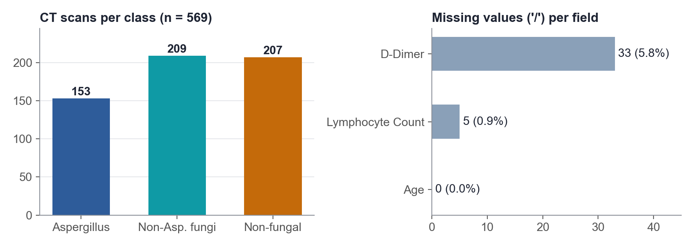
Introduction
Scope & Data
System Design
Progress & Results
Plan
Data — PAC569 Multi-Modal Dataset (OMIX014539, NGDC China)
WHAT WE DOWNLOADED
CT VOLUMES
File | Content | Cases | Size
OMIX014539-03 | Aspergillus CT (.nii.gz) | 153 | 3.53 GB
OMIX014539-04 | Non-Aspergillus fungi CT | 209 | 4.88 GB
OMIX014539-05 | Non-fungal CT | 207 | 4.67 GB
OMIX014539-08 | Clinical variables (.csv) | 569 rows | 28 KB
• One volume per case: CaseXXX.nii.gz, IDs match the CSV 569 / 569, labels agree 100%
• Geometry (all 569): 512 × 512 in-plane (0.50–0.97 mm), 31–81 slices (median 65), all 5 mm thick
• Intensity: raw Hounsfield units (air ≈ −1000, soft tissue ≈ 0–100)
• No lesion masks, no severity labels
CLINICAL VARIABLES (12)
Group | Variables
Demographics | Gender, Age
Comorbidity | Solid tumour, Diabetes, Renal dysfunction, AIDS
Treatment | Immunosuppressants
Laboratory | Lymphocyte count, D-dimer
Fungal markers | (1,3)-β-D-glucan (G), GM antigen
A 13th column, Pathogen Identification, is 1 for every row and is dropped. Source: ngdc.cncb.ac.cn/omix/release/OMIX014539 (released 11 Sep 2026, Wuxi People's Hospital).
4
Notes:
[Slide 4 · Speaker A · ≈ 0:41]
Our data is PAC569, a public dataset released in September 2026: 569 chest CT scans from four hospitals, with 153 Aspergillus, 209 other fungal and 207 non-fungal cases.
We checked every file: each CT matches exactly one clinical record with the same label. Each record has twelve variables, including AIDS and diabetes status, two blood tests and two fungal markers, G and GM. But there are no lesion outlines and no severity scores — which is why severity is only a "could-have".

Slide 5
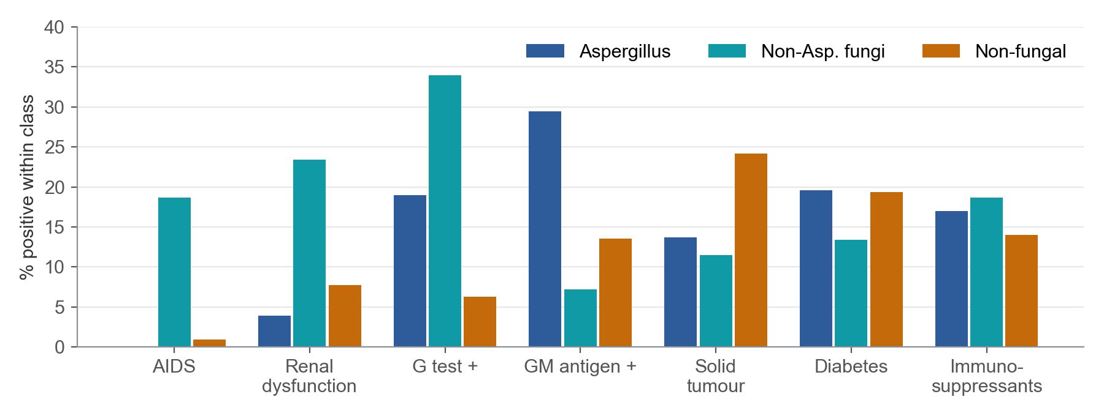
Introduction
Scope & Data
System Design
Progress & Results
Plan
Data Exploration — What We Found Before Modelling
CLINICAL RISK FACTORS DIFFER BY CLASS
DATA-QUALITY CHECKS
21 repeated clinical records
21 rows repeat the previous row exactly (consecutive IDs) → likely repeat scans of one patient. Grouped into 548 patient groups; a group never crosses splits.
Missing values
D-dimer 33 ('/'), lymphocyte count 5. Imputed with training-set median.
Inconsistent coding
AIDS: 39 of 41 AIDS patients are in the non-Aspergillus fungal class. GM antigen is positive in 29.4% of Aspergillus cases; G-test in 34.0% of non-Aspergillus fungal cases.
Gender values with trailing spaces ('F ' vs 'F'); constant Pathogen Identification column.
Implication: clinical data carry real signal, but no single marker separates the classes — each is positive in a minority. G / GM are themselves diagnostic criteria, so we also report results with and without them to check for label shortcuts.
No lesion / severity ground truth
Localisation becomes weakly supervised (Grad-CAM); severity needs an agreed proxy definition.
Class balance is moderate (153 / 209 / 207) → class-weighted loss, macro-F1 as primary metric.
5
Notes:
[Slide 5 · Speaker A · ≈ 0:57]
Before building any model, we explored the data, and three findings changed our decisions.
First, clinical risk factors do differ by class — for example, 39 of the 41 AIDS patients are in the other-fungal group — but no single marker separates the classes. So clinical data can help, but not alone.
Second, G and GM are themselves diagnostic tests, so a model could simply copy them. We therefore always test with and without them.
Third, 21 records look like repeat scans of the same patient. We grouped them, so one patient can never appear in both training and test.
With the data understood, B will explain how we turn it into a model.

Slide 6
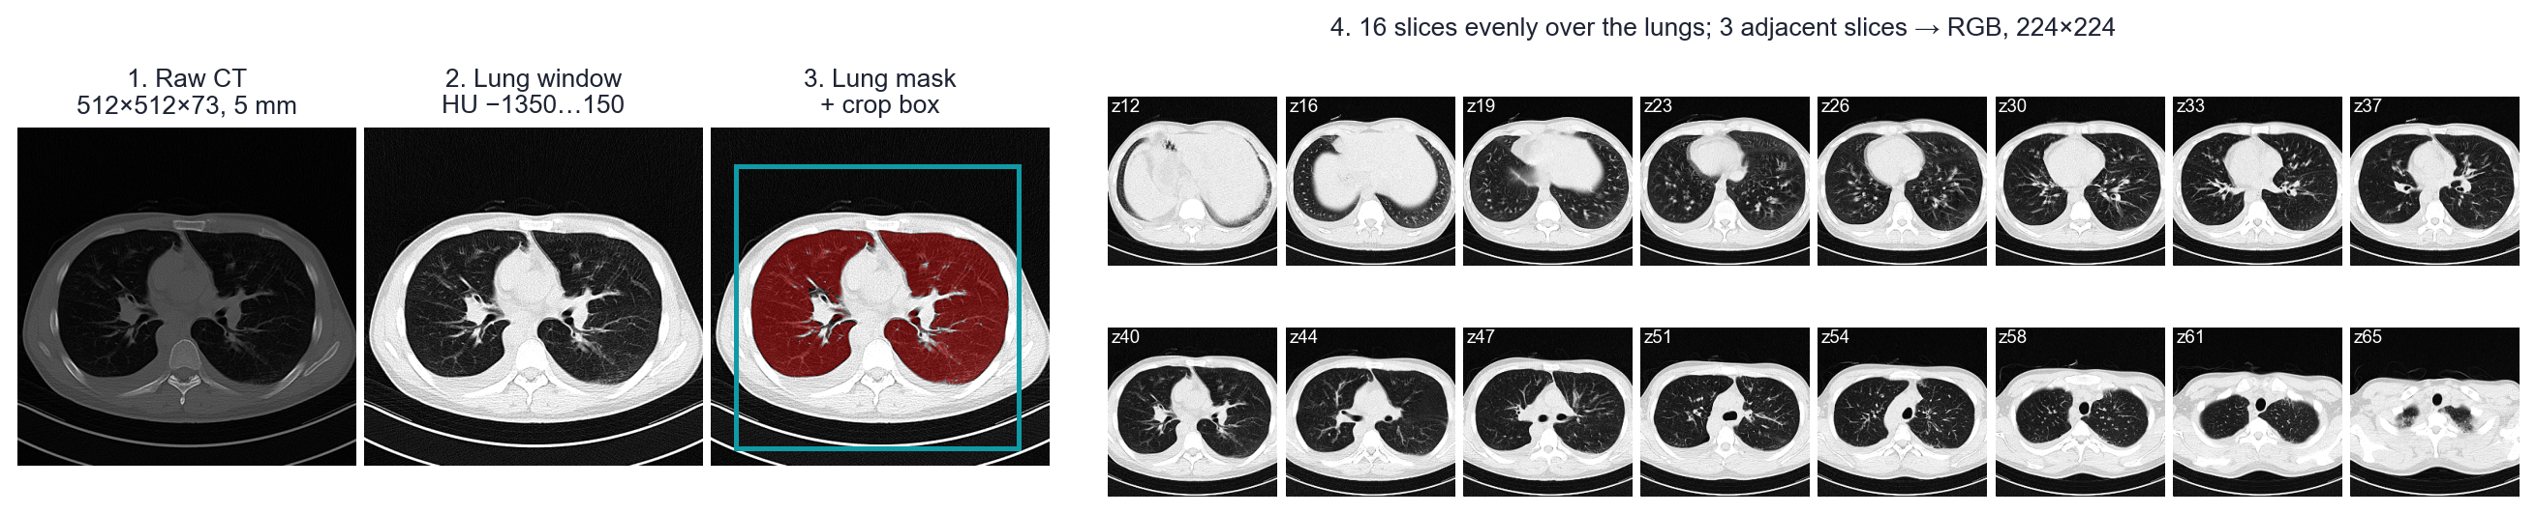
Introduction
Scope & Data
System Design
Progress & Results
Plan
Data Pipeline — CT Preprocessing and Leak-Free Split
CT PREPROCESSING (IMPLEMENTED)
PATIENT-GROUP STRATIFIED SPLIT · SEED 42
• 70 / 15 / 15 split over patient groups, stratified by class
• No leakage: repeat scans stay together; imputer, scaler and encoder are fitted on train only
• Augmentation only on training cases: ±10° rotation, ±5% shift (same transform for all slices)
• Crop QA: 12 / 569 first-version crops kept only one lung (a fully consolidated lung is not 'air') → box now mirrored about the body midline; all models retrained
Split | Aspergillus | Non-Asp. fungi | Non-fungal | Scans | Groups
Train | 107 | 150 | 145 | 402 | 383
Val | 23 | 30 | 31 | 84 | 82
Test | 23 | 29 | 31 | 83 | 83
Total | 153 | 209 | 207 | 569 | 548
6
Notes:
[Slide 6 · Speaker B · ≈ 1:18]
Thank you. A CT scan is a stack of about sixty images, but an image network needs one fixed-size input. So each scan goes through four steps: a lung window, a lung mask, a crop around the chest, and sixteen slices taken evenly from the bottom to the top of the lungs. Three neighbouring slices form one colour image, which gives the network a little depth. Why sixteen? Patients have between 31 and 81 slices, so a fixed number gives everyone the same input.
Checking the output taught us a lesson: our first crop missed one lung in 12 patients — the sickest ones, whose lung was completely white and no longer looked like air. We fixed it and re-ran everything.
At the bottom is our split: 70, 15 and 15 percent, balanced by class and kept by patient group, as A described. Augmentation — small rotations and shifts — is applied to training data only.

Slide 7
Introduction
Scope & Data
System Design
Progress & Results
Plan
System Design — Multimodal Architecture
CT BRANCH
Chest CT
Preprocess
ResNet-18
Mean pool
NIfTI volume
512×512×31–81, HU
lung window, lung crop,
16 slices × 3 adjacent
→ 224×224
ImageNet pre-trained,
shared over 16 slices
→ 16 × 512
patient-level
512-d
Concat
MLP head
512 + 64
= 576-d
dropout,
softmax ×3
CLINICAL BRANCH
Clinical record
Encode
Clinical MLP
12 variables
median impute, z-score,
one-hot (train-fit only)
2 layers → 64-d
Grad-CAM
Outputs
saliency on the CT slices
→ lesion localisation
class probabilities,
'uncertain' flag
BASELINES SHARE THE SAME PARTS
• CT-only: same CT branch + head, clinical branch removed
• Clinical-only: logistic regression / random forest / LightGBM on the encoded record
• Training: class-weighted cross-entropy, AdamW, cosine LR, mixed precision; model chosen on validation macro-F1
Why 2.5D, not 3D? Slices are 5 mm thick, so a 3D network gains little along z; 2D ImageNet weights transfer directly, and 16 slices × 224² fits our 8 GB GPU. 3 adjacent slices as RGB keep local z-context.
7
Notes:
[Slide 7 · Speaker B · ≈ 1:13]
The model has two branches. The image branch sends all sixteen slices through a ResNet-18 pretrained on ImageNet. With only about four hundred training patients, we cannot train a deep network from scratch, so we start from one that already recognises edges and textures, and average the slices into one summary per patient.
The clinical branch cleans and scales the twelve variables, using training data only, and passes them through a small network. The two summaries are joined, and a classifier outputs the three probabilities. Grad-CAM later shows which image regions drove the answer. We train with a class-weighted loss, so the smaller Aspergillus class counts fully, and keep the epoch with the best validation score.
Why not a full 3D network? The slices are five millimetres thick, so there is little detail along that direction, and 2D lets us reuse pretrained weights on our 8-gigabyte GPU.

Slide 8
Introduction
Scope & Data
System Design
Progress & Results
Plan
Experimental Design — Two Comparison Groups: Data First, Then Model
Experiment 1 · Data
Experiment 2 · Model
What goes into the model? — run first
How should it learn? — on the best data setting
1a · Preprocessing
lung masking on / off; lung window vs multi-window channels
2a · Modality
CT only / clinical only / fusion; clinical with / without G & GM
Supervisor: pre-trained baseline
1b · Augmentation
none / basic / extended (scale, intensity, noise, cut-out)
Supervisor: augmentation
2b · Fusion method
feature concatenation vs late fusion of probabilities
1c · Training size
25 / 50 / 75 / 100% of training groups; val + test fixed
Supervisor: training size
2c · Backbone
ImageNet ResNet-18 vs ResNet-50
Supervisor: pre-trained baseline
2d · Structure (optional)
flat 3-class vs fungal / non-fungal first, then Aspergillus
So far only the baseline: no masking, basic augmentation, 100% data
So far only the baseline: ResNet-18, 3 modalities, concatenation
EVALUATION PROTOCOL
One factor at a time. Each comparison changes one thing against the baseline. The best data setting from Experiment 1 becomes the starting point for Experiment 2.
• Primary metric: macro-F1; also balanced accuracy, per-class recall, confusion matrix
• Model selection: on validation / 5-fold group CV only
• Test set (83 scans): used once per final configuration; 3 seeds, mean ± SD
8
Notes:
[Slide 8 · Speaker B · ≈ 1:09]
To test our ideas fairly, we organise every comparison into two experiments. Experiment 1 is about the data: preprocessing such as lung masking, how much augmentation, and how much training data. Experiment 2 is about the model: CT, clinical or both, how to fuse them, and a smaller or larger backbone. The orange tags show that all three of our supervisor's requests are covered.
We run the data experiment first, and its best setting becomes the start of the model experiment. Each comparison changes one thing against the baseline — and, as the green bars show, the baseline is the only setting run so far.
We measure macro-F1, which weights all three classes equally, choose models on validation data only, and use the 83-scan test set just once for each final configuration. Now C will show where we are.

Slide 9
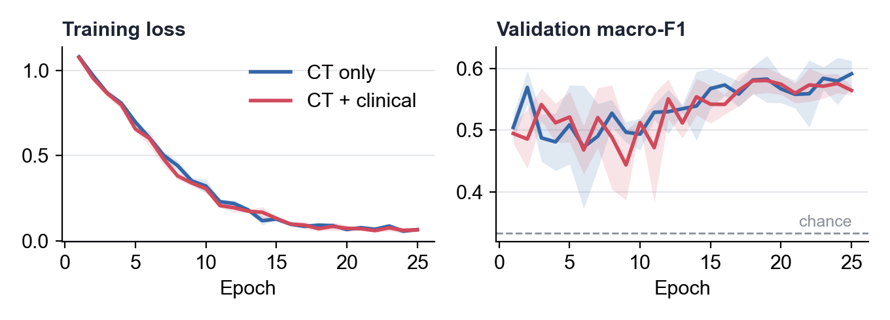
Introduction
Scope & Data
System Design
Progress & Results
Plan
Where We Are — Data Ready, Baseline Established, Main Work Ahead
WE ARE HERE
the main work — phases 2 to 5 — has not started yet
✓ 0 · Data foundation
✓ 1 · Baseline
2 · Fix data & training
3 · Main experiments
4 · Explain, severity, UI
5 · Final evaluation
DONE
DONE
WK 1
WK 2–4
WK 4–5
WK 6
• Download + ID / label check
• EDA, cleaning, repeat-scan groups
• Leak-free group split
• CT preprocessing + crop QA
• One default config, untuned
• Clinical / CT / fusion, 3 seeds
• Grad-CAM sanity check
• → diagnosis (slide 12)
• Lung masking
• Regularisation, partial freezing
• Re-run baseline
• Exp. 1 · Data: preprocessing, augmentation, training size
• Exp. 2 · Model: modality, fusion, backbone
• 3 seeds each
• Grad-CAM review
• Severity proxy
• Calibration + 'uncertain'
• Prototype UI
• Test set, once
• Error analysis
• Report + demo
WHAT THE BASELINE IS — AND IS NOT
• Is: one default configuration (ResNet-18, full training set, basic augmentation), run end-to-end with 3 seeds — it proves the pipeline works and gives the reference point.
• Is not: tuned, ablated or final. Neither comparison group — data or model — has been run beyond its default cell.
• Test numbers today are a first look; later choices use validation / cross-validation.
Baseline training, mean ± SD over 3 seeds: training loss 0.05–0.08, best validation F1 only 0.59–0.63.
9
Notes:
[Slide 9 · Speaker C · ≈ 1:16]
Thank you. This is our whole plan in six phases, and we are here — after the first two. The data foundation is done, and so is one baseline: the default setting from the previous slide, run end to end with three seeds. Everything is scripted, so every number here can be regenerated, and one run takes about 3.3 minutes on a laptop GPU, so the full plan is realistic.
To be clear, the baseline is not tuned and not final. It proves the pipeline works and gives us a reference point. The main work — both experiment groups — starts now.
Even so, it already tells us something. On the bottom right, the training loss falls almost to zero, but validation F1 only reaches about 0.59 to 0.63. The model learns its training patients far better than new ones. Keep this gap in mind — it comes back on slide 12.

Slide 10
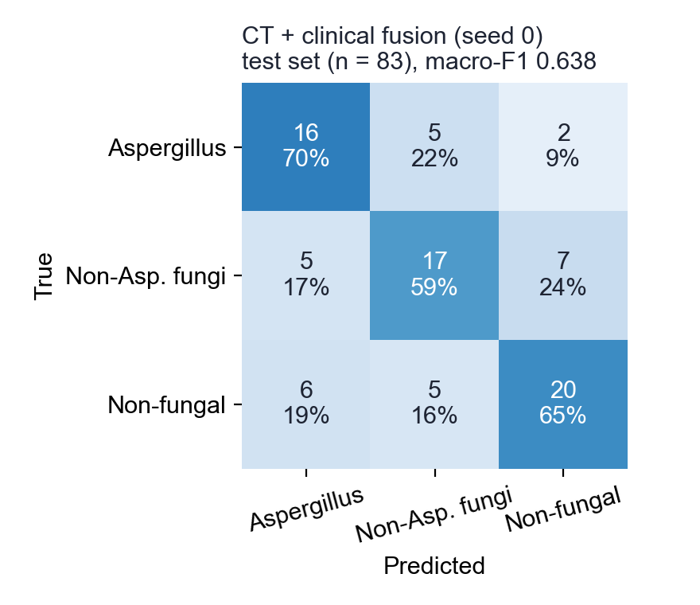
Introduction
Scope & Data
System Design
Progress & Results
Plan
Baseline Results — One Untuned Configuration on the Fixed Split
MACRO-F1 (CHANCE = 0.333)
Model | Features | 5-fold CV (train+val) | Test, 3 seeds
Logistic regression | clinical | 0.495 ± 0.065 | 0.512 (deterministic)
Random forest | clinical | 0.569 ± 0.035 | 0.539 ± 0.017
LightGBM | clinical | 0.524 ± 0.061 | 0.597 (deterministic)
Random forest | clinical − G/GM | 0.532 ± 0.062 | 0.561 ± 0.010
ResNet-18 (2.5D) | CT only | — | 0.642 ± 0.014
ResNet-18 (2.5D) | CT + clinical | — | 0.618 ± 0.020
Highlighted: best clinical model and best image model, chosen on validation macro-F1.
Reading so far (first, untuned runs)
• Clinical alone: CV macro-F1 ≈ 0.57; dropping G/GM costs only 0.037 → no obvious marker shortcut.
• CT-only ResNet-18 is the best so far (0.642 ± 0.014).
• Fusion (0.618 ± 0.020) does not beat CT-only yet.
• These are baseline numbers — why, and what we change next, is on slide 12.
Fusion model, seed 0, 83-scan test set. Most common error: non-Asp. fungi predicted as non-fungal (7 of 29).
10
Notes:
[Slide 10 · Speaker C · ≈ 1:14]
Here are the baseline numbers, all as macro-F1, where guessing gives 0.33.
Clinical data alone reach about 0.57. Removing G and GM costs only 0.037, so the model is not just copying the tests — which answers the concern A raised.
CT alone is our best model so far, at 0.642 plus or minus 0.014 over three seeds. Per class, it finds 67 percent of Aspergillus, 56 percent of other fungal and 71 percent of non-fungal cases. Combining CT and clinical data gives 0.618, so at this stage fusion does not help. That is not what our hypothesis predicted, and we report it as it is.
In the confusion matrix, rows are the true class and columns the prediction. The weakest row is other fungi, most often mistaken for non-fungal — 7 of 29 cases. Please read all of this as a starting point from one untuned setting.

Slide 11
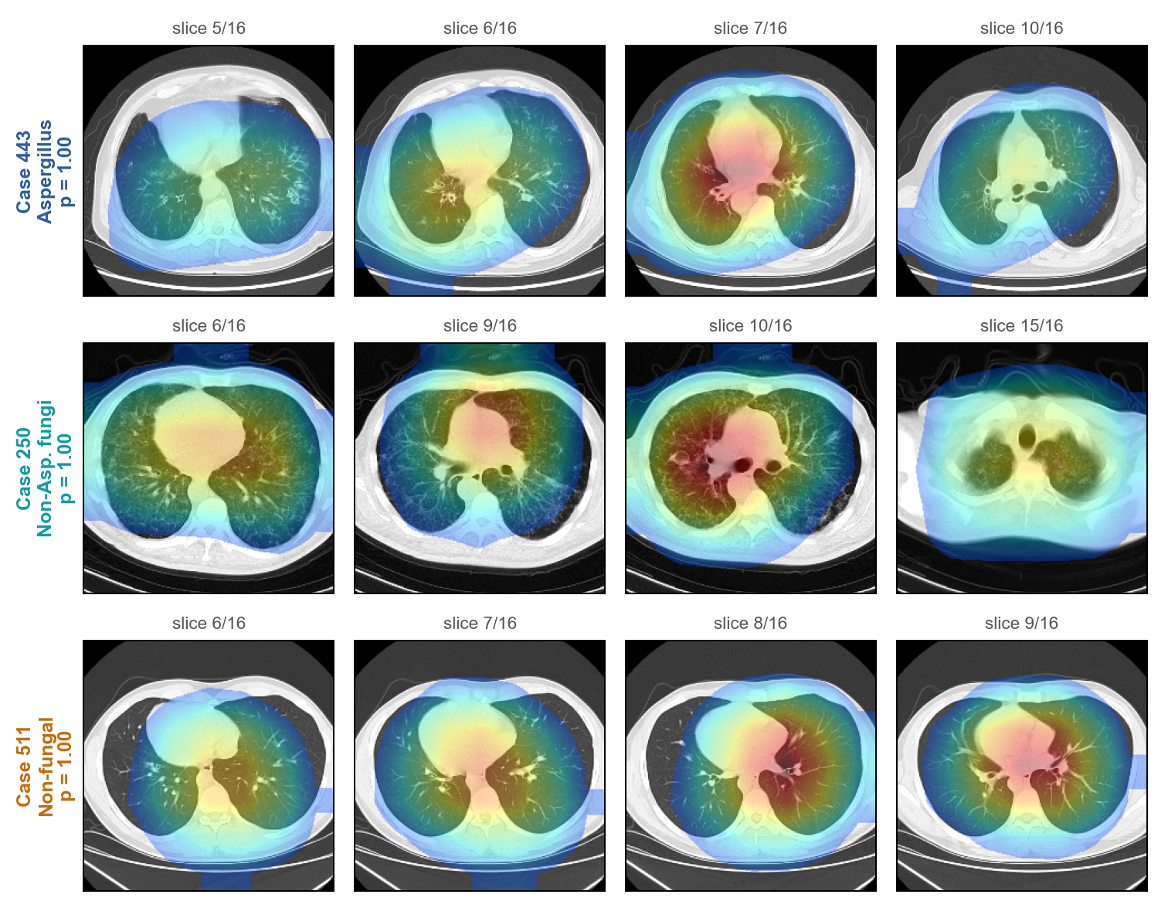
Introduction
Scope & Data
System Design
Progress & Results
Plan
Baseline Sanity Check — Where Does the Model Look? (Grad-CAM)
WHAT WE SEE
• Method: Grad-CAM on ResNet layer 4 for the predicted class; 4 slices with the most saliency per case (most confident correct test case per class).
• Consistent pattern: in all three cases the heat sits on the mediastinum and hila (heart, great vessels, central bronchi), not on peripheral lung opacities.
• Interpretation: the model may be using anatomy or scan-specific cues rather than infection patterns — a warning sign rather than a finding.
Why it matters
• A good F1 is not enough — we must check where the model looks
• Every case shows p = 1.00 → the probabilities are overconfident
11
Notes:
[Slide 11 · Speaker C · ≈ 1:13]
A good score is not enough; the model should also be right for the right reason. So we used Grad-CAM, which shows in red the regions that drove each prediction. These are three test cases the model got right with high confidence, so we expected the red to sit on the infection. For each case we show the four slices it relied on most.
It does not. In all three, the red sits on the heart and central airways, not on the lung shadows. The model may be relying on anatomy or scanner details — something that could fail at a new hospital. And every prediction says one point zero, so the model is overconfident. We see both as warning signs found early, exactly the kind of problem a baseline should expose before we spend weeks on experiments, and D will explain what we do about them.

Slide 12
Introduction
Scope & Data
System Design
Progress & Results
Plan
From Baseline to Next Experiments — What the First Run Tells Us
OBSERVATION → DIAGNOSIS → NEXT STEP
What we observed | What it suggests | What we change next
Training loss 0.05–0.08, validation F1 0.59–0.63 | The network memorises ~400 training scans | Augmentation (Exp. 1), partial freezing, stronger regularisation
Grad-CAM heat on mediastinum / hila | Model may rely on non-lung cues | Mask non-lung pixels, re-run baseline, re-check saliency
Fusion 0.618 vs CT-only 0.642 | 64-d clinical vector outweighed by 512 CT features | Late fusion of CT and clinical probabilities (Exp. 2)
Predicted probabilities ≈ 1.00 | Overconfident outputs | Temperature scaling before the 'uncertain' flag
12 one-lung crops (already fixed) | Preprocessing needs routine QA | Crop-size check kept in the pipeline
✓ Baseline
(we are here)
Fix data & training
masking, regularisation
Exp. 1 · Data
prep, augmentation, size
Exp. 2 · Model
modality, fusion, backbone
Test set
once
1 · Data fixes → re-run everything
2 · Augmentation ≠ more patients
3 · Test set used once
Masking or crop changes alter the input, so the baseline is re-run too — otherwise comparisons are unfair.
It is a training-time factor compared in Exp. 1; the dataset and the split stay unchanged.
Choices are made on validation / 5-fold group CV; today's test numbers are a first look only.
12
Notes:
[Slide 12 · Speaker D · ≈ 1:47]
Thank you. We treat the baseline as a diagnosis. Each row in this table is a problem we saw, what it suggests, and what we will change.
The training–validation gap means the network memorises our training patients, so we add augmentation and regularisation. Grad-CAM on the heart means we mask out everything except the lungs. Weak fusion means the 64 clinical numbers are drowned out by 512 image numbers, so we will train the two models separately and combine their probabilities. This late fusion is part of Experiment 2. And overconfidence means we calibrate before building the "uncertain" flag. And the crop bug we already fixed reminds us to keep checking the preprocessing.
The arrows show the order, and the order matters. We fix the data first, because every later result depends on it — fixing it later would mean redoing everything. Then the data experiment, then the model experiment, and the test set only at the very end.
Three rules keep this honest: if the data changes, we re-run everything; augmentation is not extra patients; and today's test numbers were only a first look. If we kept checking the test set while tuning, we would slowly fit our choices to those 83 scans, and the final score would look better than it really is.

Slide 13
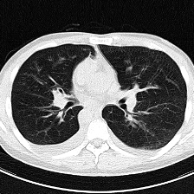
Introduction
Scope & Data
System Design
Progress & Results
Plan
Prototype Interface and Timeline
PLANNED UI (MOCK-UP)
TIMELINE
Wk 1
Lung masking, regularisation → re-run baseline, re-check Grad-CAM
Clinical record · Case 071
Age 27 · M
Immunosuppressants − · AIDS −
G − · GM −
Lymphocytes 2.41
D-dimer n/a
Wk 2
Exp. 1 · Data: preprocessing, augmentation, training size
Wk 3
Exp. 2 · Model: modality, late fusion
Wk 4
Exp. 2 · Model: backbone, fungal-first variant; severity proxy
Prediction
Wk 5
Prototype UI, calibration and 'uncertain' threshold
Aspergillus
Wk 6
Final test-set runs, error analysis, report
Non-Asp. fungi
Non-fungal
RISKS & MITIGATION
• Small data (569 scans): pre-training, augmentation, seeds + CV
• Repeat scans / leakage: group-level split
• No lesion masks: saliency only, reviewed qualitatively
• Severity undefined: stretch goal, proxy agreed with supervisor
◀ slice 40 / 73 ▶ ☐ show saliency
(probabilities illustrative)
Research prototype — decision support only, not a diagnosis.
13
Notes:
[Slide 13 · Speaker D · ≈ 1:05]
Finally, what users will see and when. On the left is our interface with a real case: the CT viewer with an optional saliency overlay, the clinical record, the three probabilities, and an "uncertain" message when the model is unsure.
The timeline follows the same order: fixes in week one, the data experiment in week two, the model experiment in weeks three and four together with the severity definition, the interface in week five, and the final test and report in week six. For severity, one simple option is the share of lung that is denser than normal, which needs no extra labels; we will agree it with our supervisor. The main risks — a small dataset, repeat scans and missing lesion masks — each have a mitigation listed below.

Slide 14
NUS-ISS · PATTERN RECOGNITION SYSTEMS · PRACTICE MODULE · FIRST PRESENTATION
Thank You
Questions & Answers
A Multimodal Medical Imaging Assistant for Pulmonary Infection Classification
Notes:
[Slide 14 · Speaker D · ≈ 0:26]
To sum up: these infections are hard to tell apart, and we want to know whether CT plus clinical data can do it. The data and pipeline are ready, the baseline runs, and it has shown us exactly what to fix next. Thank you — we are happy to take your questions.

